Slide 1

Statistical Analysis on Historical weather data of Santa Barbara
Satya Alekhya D
satyalekhyadsln@gmail.com

Slide 2

AGENDA
03 Introduction
04 Data Description
05 Data Understanding & Cleaning
06 Data Visualization
11 Statistical Analysis
18 Conclusion

Slide 3

INTRODUCTION
The main objective of the analysis is to draw meaningful insights from
the dataset using MS Excel
It is Historical weather data of Santa Barbara, a city in central California
coast, United States.
The data is collected from the “Kaggle” Website.

Slide 4

Data Description
This data was collected manually from Weather Underground.
This data was collected manually from Weather Underground.
Variables contained are:
Date, Average Temperature (ºF),
Average Dew Point (ºF),
Average Humidity (%),
Maximum Wind Speed (mph)
Average Wind Speed (mph)
Average Pressure (in Hg)
Precipitation (in).

Slide 5

Data understanding and cleaning
The steps included in Data analysis Initially we need to transform the raw data by the steps:
DATA CLEANING :
As observed from the data set, the values of the year 2015 were recorded from the middle of the year. This may cause some inefficiency in our analysis, so we removed records from 2015.
The actual dataset is considered from the year 2016-2022
CONDITIONAL FORMATTING :
Using the Filter function in MS Excel, we check for the null values in the records in each column. This also helps to understand the range of values in each variable.

Slide 6

Data visualization
Visualizing data helps us to understand the distribution of data points. This gives us a clear understanding of hidden patterns.

Slide 7
Temperature OVER YEAR
The graph is of Temperature over the year.
The Data points indicate that temperature has been decreasing over the years
Temperature is on Y-Axis and X-Axis

Slide 8
Temperature vs humidity
From the above graph, the pattern of temperature and humidity over the years has been constantly approaching
To a similar point in the year 2022.

Slide 9
WIND VS PRECIPITATION
In general, the relationship between Wind speed and Precipitation goes hand in hand. For this data, we can show their relation by calculating the Correlation Coefficient. So the Coefficient obtained was 0.1505 which shows a positive and decent relation. Graphically it is shown as

Slide 10
HUMIDITY VS PRESSURE
Humidity and Pressure are inversely proportional. Hence, when there is an increase in Pressure, the humidity decreases gradually.

Slide 11
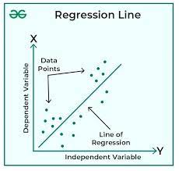
Statistical Analysis
Statistical Analysis: Statistical Analysis involves Regression analysis, Forecasting time series.
Regression is a statistical technique that analyzes the relationship between two or more variables. It can also be used to predict the value of one variable based on the values of the others.
In regression, a dependent variable is related to one or more independent variables. The dependent variable is usually represented by the letter y and the independent variable by the letter x.
A regression line is a line drawn through the middle of all the data points on a chart. It can be calculated using a statistics program like Excel. And forecasting

Slide 12
Linear REGRESSION
Regression analysis is a powerful statistical method that allows you to examine the relationship between two or more variables of interest.
From the data, the relationship between variables can be shown with regression Coefficients such as Windspeed vs Precipitation(Linear), Humidity vs Temperature, Pressure(Multiple)
Comparison of Windspeed vs Precipitation
Windspeed(Y)= Dependent Variable
Precipitation (x)= Independent variable
Linear Regression which is between two variables. Y = Bo + B1x
Null Hypothesis :
Ho: There is no relation between Y and X or
VS
Alternative Hypothesis :
H1: There is a significant relation between Y and x variables

Slide 13
Linear REGRESSION
OUTPUT INTERPRETATION :
1)Multiple R=0.1505.The maximum Windspeed has a positive coefficient
. It implies that R too has a positive sign. So they are positively related.
2)R^2=0.0226.It shows a 2.3% variation explained by Y with respect to X.
3)Significant F=4.752E-13 ~ 0.00
So , P(0.00)<Alpha(0.05) Reject H0 which is
H0:There is no significant relation between
Windspeed and Precipitation.
4)The Regression equation of the form: Y=beta0+betaX.
Y=-0.052+0.0072X
5)Inference: We conclude that There is a significant relation between Windspeed and Precipitation.
SUMMARY OUTPUT
Regression Statistics
Multiple R | 0.150548
R Square | 0.022665
Adjusted R Square | 0.022236
Standard Error | 0.20496
Observations | 2284
ANOVA
 | df | SS | MS | F | Significance F
Regression | 1 | 2.223104 | 2.223104 | 52.920395 | 4.75246E-13
Residual | 2282 | 95.86331 | 0.042008
Total | 2283 | 98.08641
 | Coefficients | Standard Error | t Stat | P-value | Lower 95% | Upper 95% | Lower 95.0% | Upper 95.0%
Intercept | -0.05216 | 0.013161 | -3.96347 | 7.614E-05 | -0.07797405 | -0.02636 | -0.07797 | -0.02636
Maximum Wind Speed (mph) | 0.00724 | 0.000995 | 7.274641 | 4.752E-13 | 0.005288111 | 0.009191 | 0.005288 | 0.009191

Slide 14
MULTIPLE REGRESSION
Multiple Regression: is a statistical technique that analyzes the relationship between a single dependent variable and multiple independent variables. The goal is to use the known values of the independent variables to predict the value of the dependent variable. The objective of multiple regression analysis is to use the independent variables whose values are known to predict the value of the single dependent value.
Comparison of Humidity VS Temp(x1) , Pressure(X2)
Humidity (Y)= Dependent Variable
Temp(x1) , Pressure(x2) = Independent variable
Multiple Regression which is between two or more variables Y = Bo + B1x1+B2x2
Null Hypothesis :
Ho: There is no relation between Y and x1, x2 or Temp & Pressure are not significant to predict the Humidity
VS
Alternative Hypothesis :
H1: There is a significant relation between Y and x1, x2 variables

Slide 15
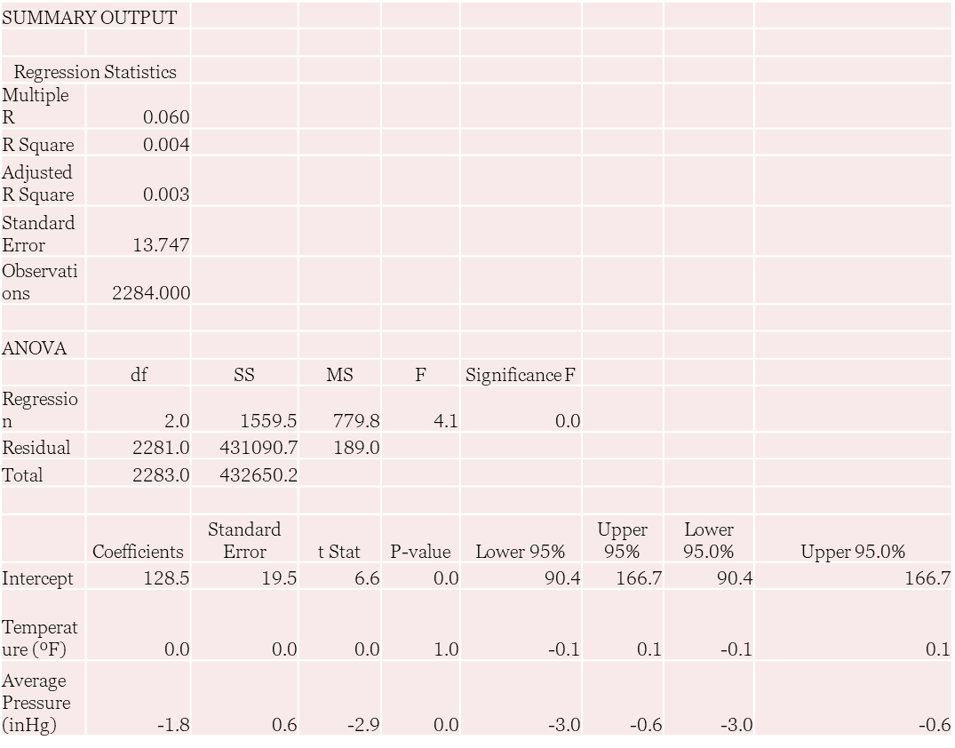
MULTIPLE REGRESSION
OUTPUT INTERPRETATION:
Multiple R=0.060 is positive. But the coefficients of temperature and Pressure are negative.
So, r must be negative. This shows there may be a negative relation between the variables.
The coefficient of determination R^2 is 0.0036. This shows 0.36% of the variation in Y is explained by X1, X2.
Significant F=0.0162.So.P(0.0162)<alpha(0.05) REJECT H0.
The regression equation of the form: Y=beta0+betaX1+beta2X2. Y=128.527-0.0018X1-1.8091X2.
Inference: We conclude that there is a significant relation between the variables.
From the table, the P value of temperature is 0.969. which is > 0.05.So temperature is not a significant factor in humidity.
P value of pressure is 0.004.which is less than 0.05.So Pressure is significant factor for humidity

Slide 16

FORECASTING
Forecasting is the process of making predictions based on past and present data.
The predictions can then be compared against what actually happens.
For example, a company might estimate their revenue in the next year, and then compare it against the actual results
Forecasting might refer to specific formal statistical methods employing time series data, or to less formal judgmental methods or the process of prediction and resolution itself.
"prediction" is used for more general estimates, such as the number of times floods will occur over a long period.

Slide 17
FORECASTING
Using the “Forecast sheet” in Excel, one can predict future values of any variable with respect to time: Here Temperature and Precipitation are predicted until the year 2024. So, this helps to get to know the crucial pattern to be prepared for any calamities. This was the analysis done on the WEATHER DATA OF YEAR 2015-2022. This might be just a drop in an ocean of performing analysis statistically.

Slide 18
THANK
Satya Alekhya Devarakonda
satyalekhyadsln@gmail.com
You

